Slide 1
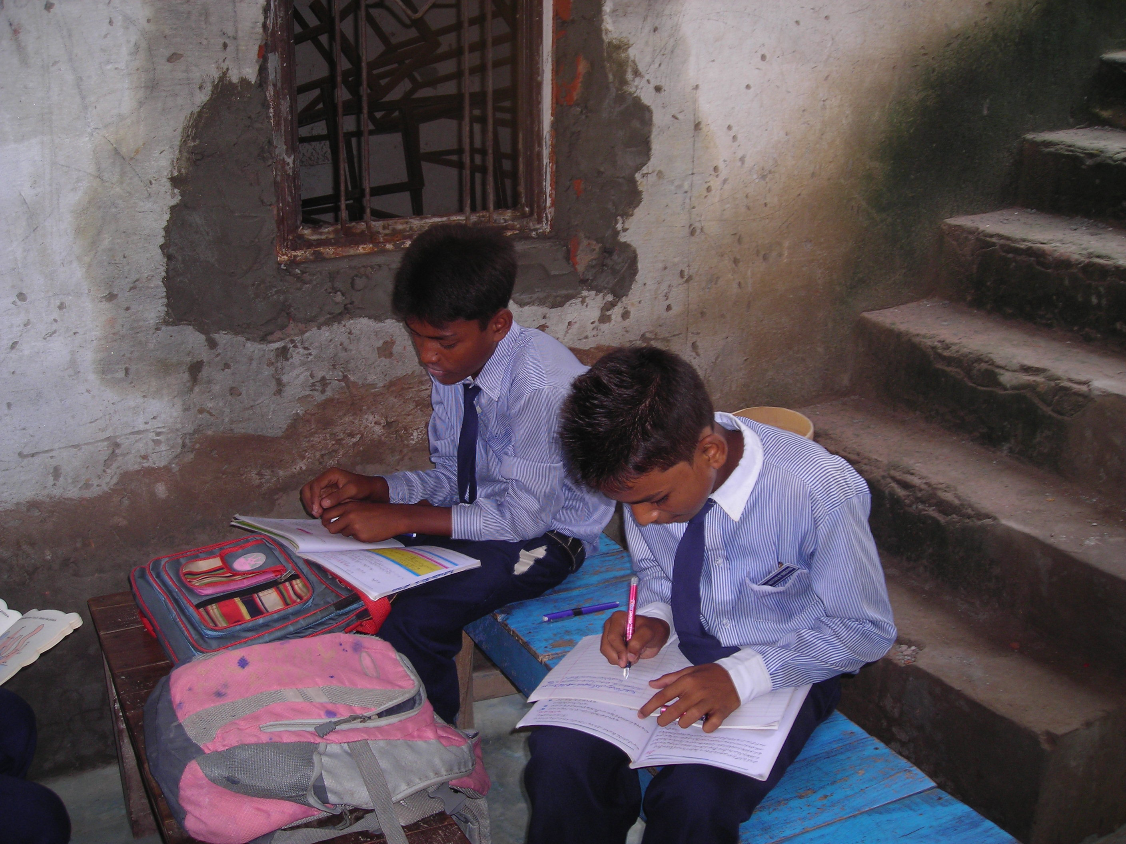
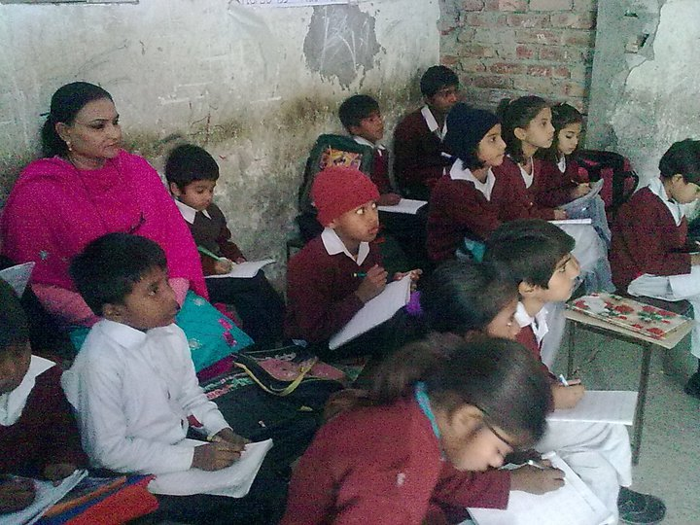
NATIONAL INSTITUTE OF EDUCATION
Transforming innocent lives through education

Slide 2
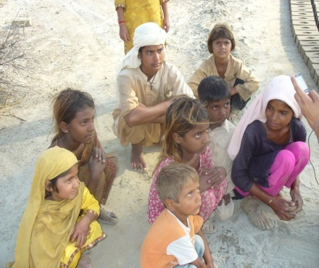
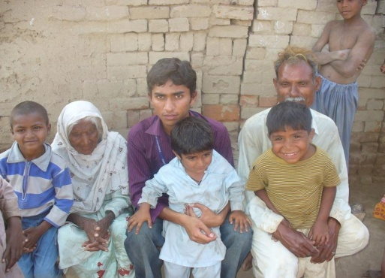
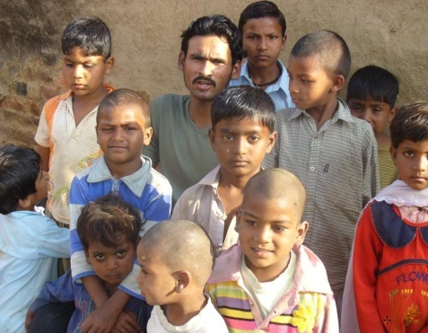
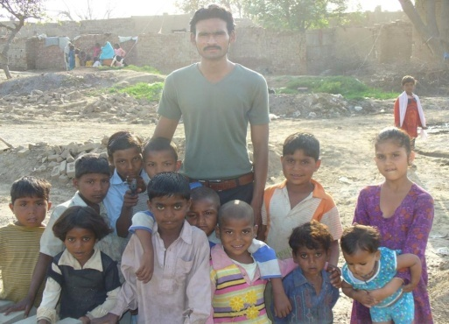
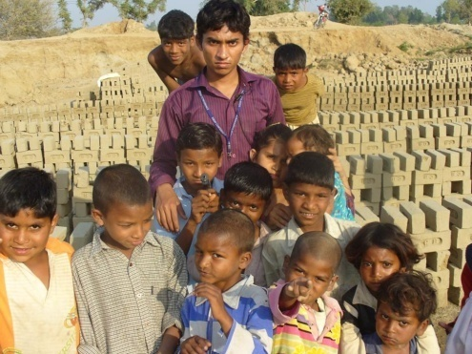
NATIONAL INSITUTE OF EDUCATION
Our Vision
“To reach the less reached which deserve for their education.”
Our Mission
National Institute of Education is committed to develop communities
through standard education in no cost.
Our Strategy
Teacher Workshops, No corporal Punishment, Visual Classes, Linguistic
classes, Better educational Atmosphere

Slide 3
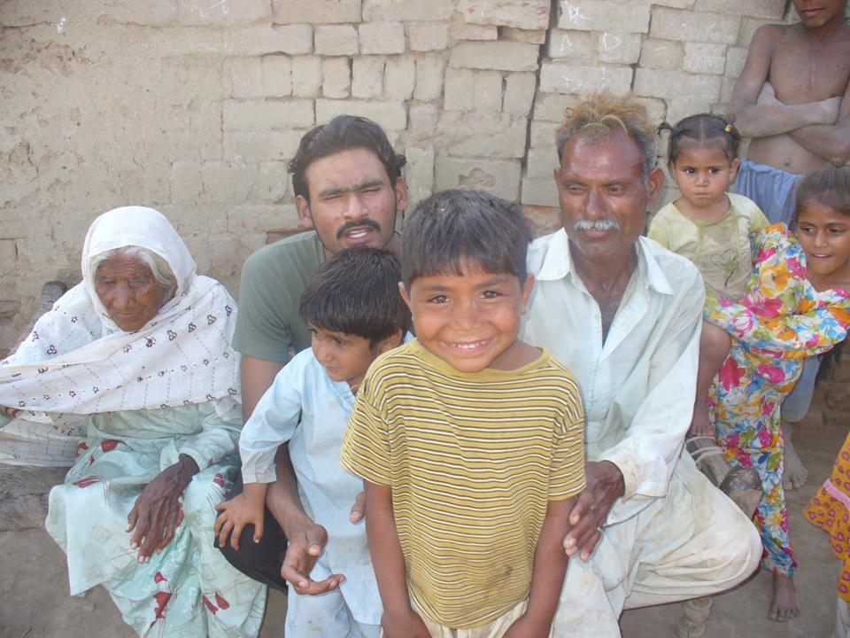
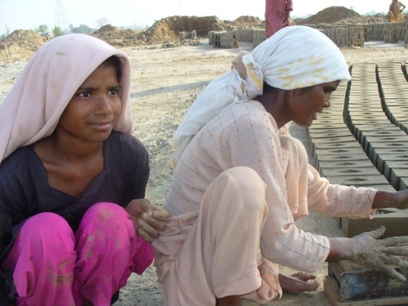
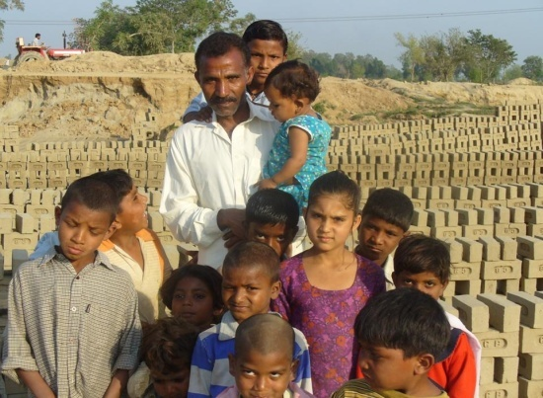
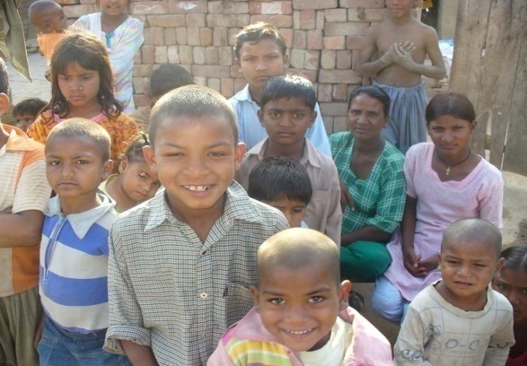
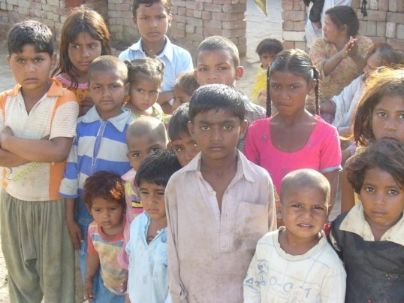
FIELD WORK
As our vision “to teach the less reached which deserve for their education” team of NIE reached to a bricks factory near to our town and convinced the parents to send their children to school.

Slide 4
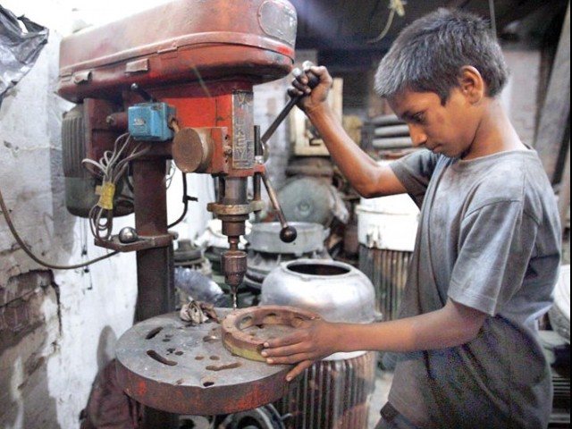
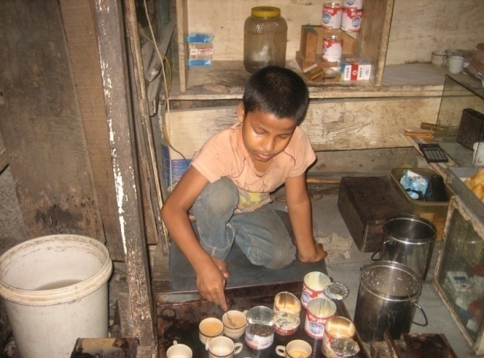
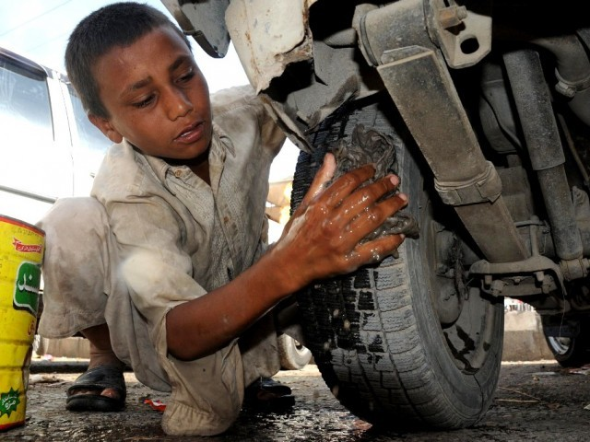
CHILD LABOUR IN PAKISTAN
In the colony of Impoverishment ,
you find only children but never childhood!
Should they not be in school…?
We NIE reach to the less reached to bring them back in their childhood in their school. We Need your prayers & Cooperation to serve them better.

Slide 5
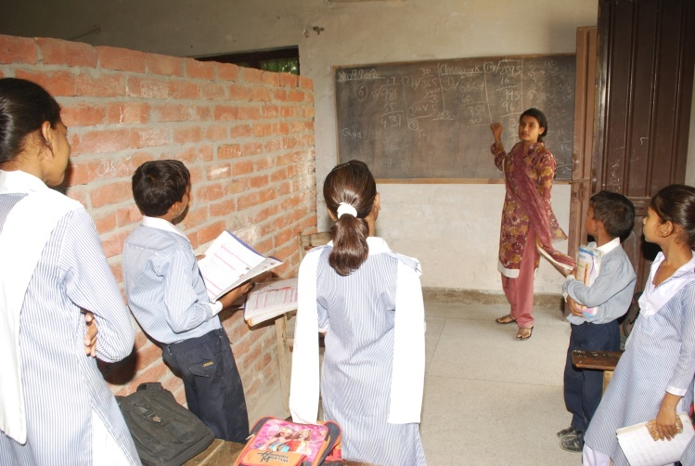
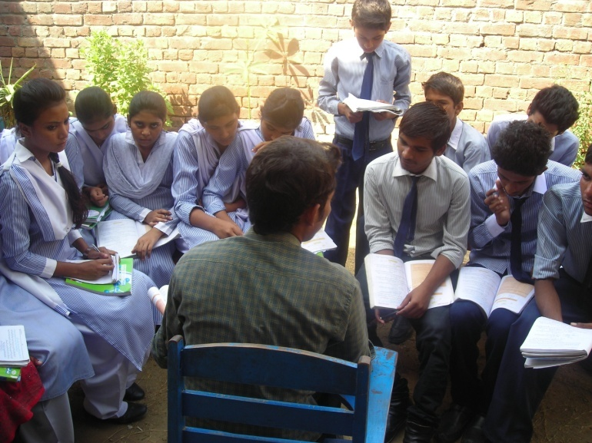
What we are doing
National Institute of Education (NIE) is source of free education for orphans, poor and dropouts. We offer our best for the students.
Students are taking their open (roofless) class. As we have no much classes but we have much students. As we have no many classrooms that’s why we have to teach openly some times.
Continue to next page…..

Slide 6
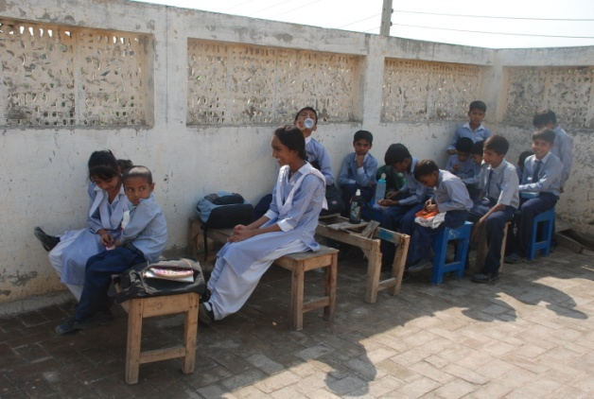
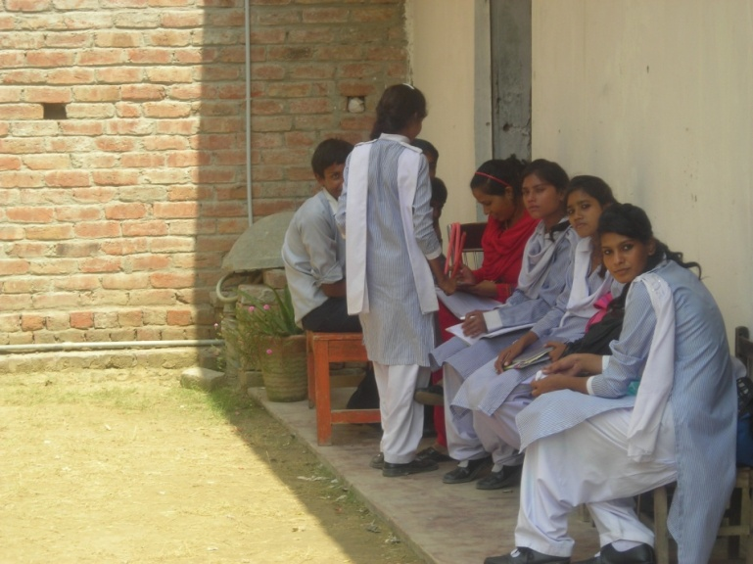
how we are doing
In photo (AA) students are sitting on the roof in their open class and busy in their lunch on their miserable furniture of class. As class is open without roof and students are sitting in the shade of the boundary wall trying to keep themselves away from the sun. (Hot sunshine of the summer).
In photo (BB) Students are sitting is the same situation as said above in (AA) where as teacher is busy to check their class test. In these summer days normally temperature goes up to 35+ degree centigrade.

Slide 7
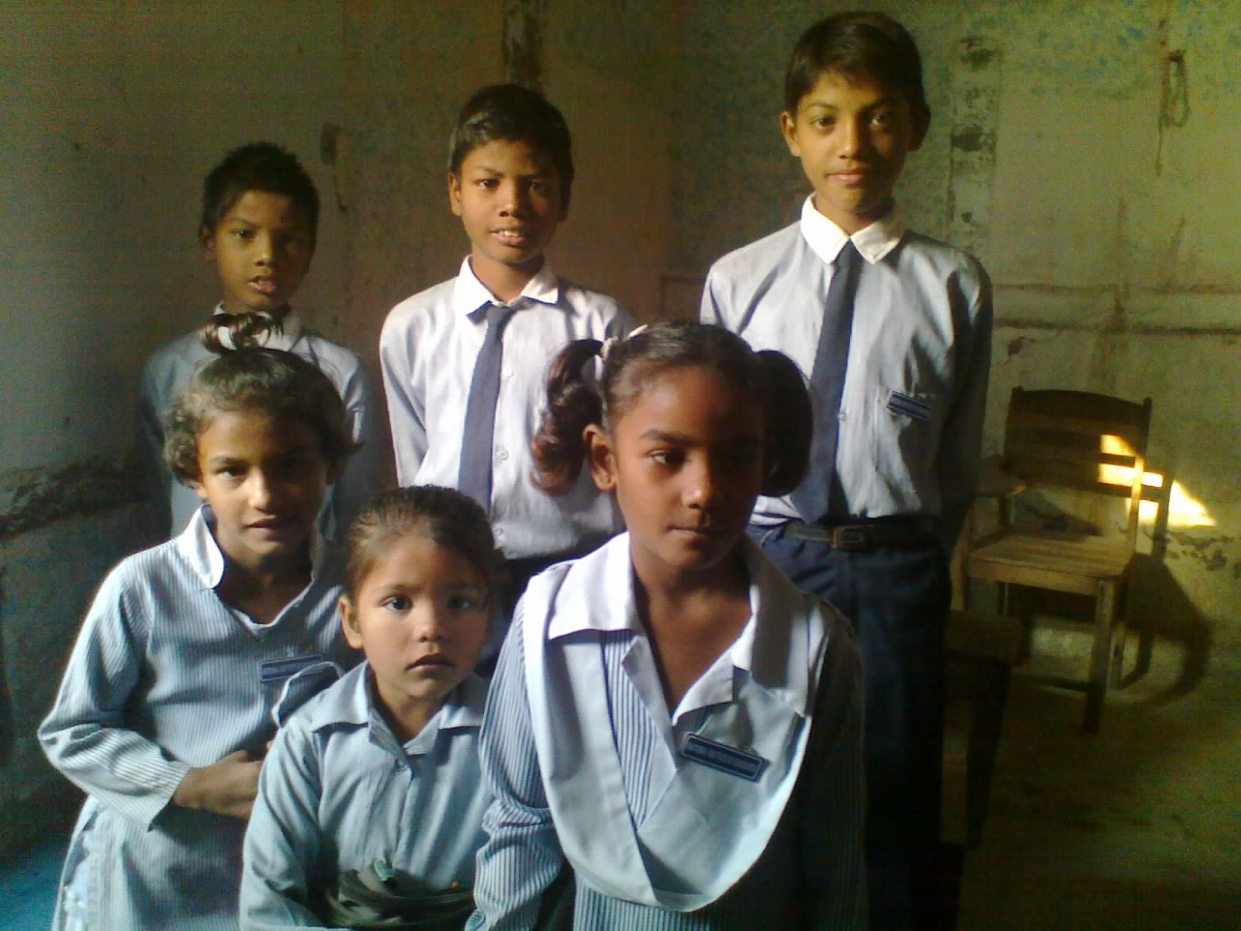
how we are doing
Orphans & Single Parents
The orphans are looked after very specially with in our sources what we have. There is no any special institute for the orphans that is why the low standard orphans are neglected in their school life.
We provide books, notebooks and also stationery for orphans and receive no fee. These students are single parents . The three boys’ father has been died about five years ago and their mother is only who earn their bread. She washes dishes, mop floors and wash clothes in some houses to feed her children. When we met her no one of her sons was going to school, as her elder son is about 10 we invited them in our school about two years ago to come and study free.
The two innocent girls are also facing the same problem single parents, where as one is orphan they were also not study in any school due to heavy monthly fee and books. They approached us and requested to admit their kids so that they can also see their daughters studying.
We are praying to God, if some one adopt one of them to afford his educational expenses for a whole year. We request you (our friends) please contact us if you can.
Jesus said, "Let the little children come to me, and do not hinder them, for the kingdom of heaven belongs to such as these.“

Slide 8
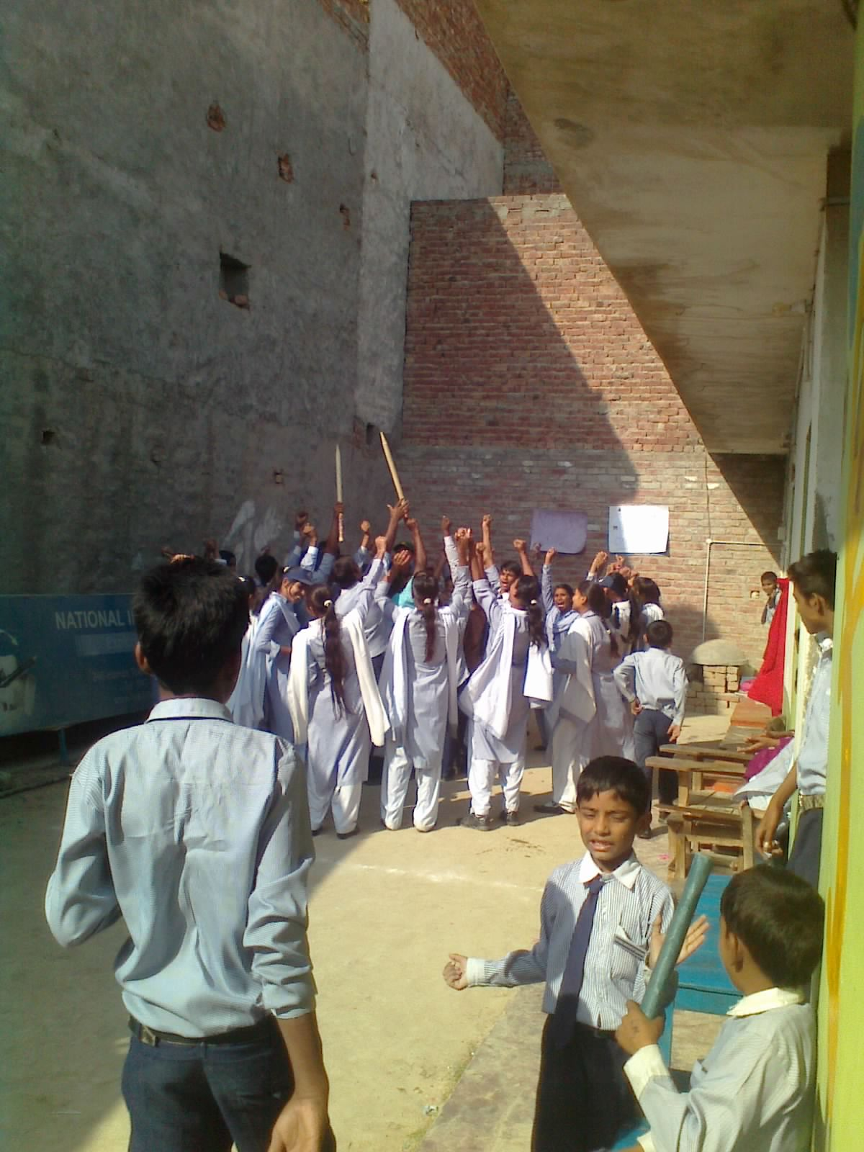
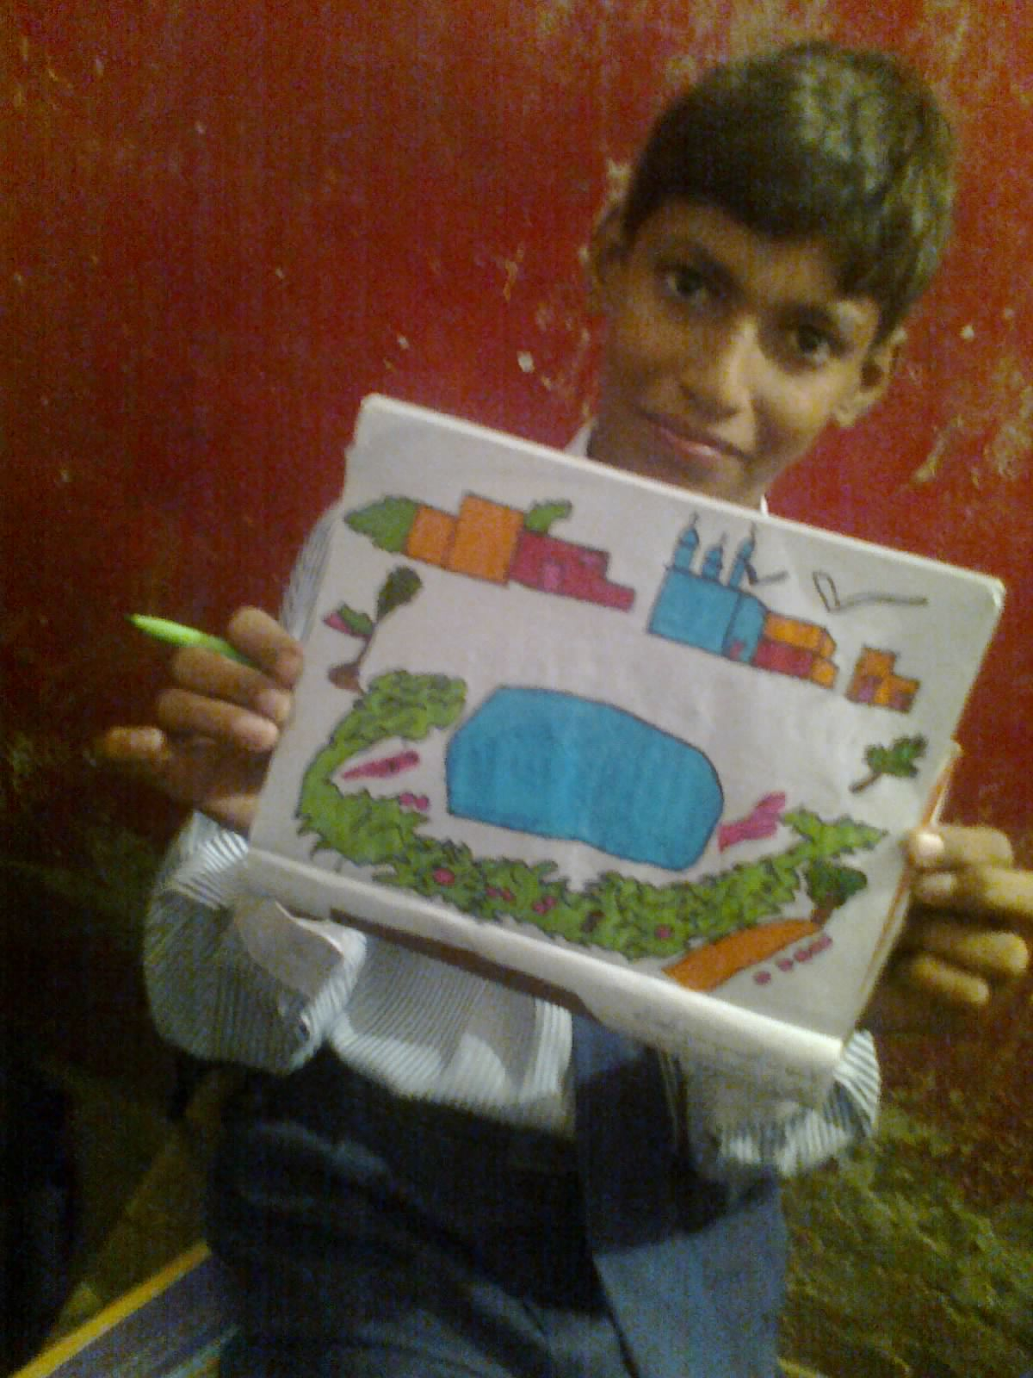
Activities we are giving
We (NIE) is trying our best to provide opportunities to our students in our school for their better educational growth. In these photos you can find the girls are shouting after winning their cricket match, where as in other photo a student of G-6 is showing his drawing. Although we have not full facilities of a school for our students but we try to provide good educational atmosphere to the children.

Slide 9
Contact details
For questions or queries; you can contact 24/7 by the following
information. We are always open.
Shafiq Rehmat
(Founder & Chairman NIE)
Khan Park Colony, 20KM Froze Pur Road Lahore - Pakistan
| +92 (300) 9432166 |
| +92 (316) 4296807 |
|shafiqnm@yahoo.com |

